Slide 1
JAVA SERIALIZATION
BY SHIVAM

Slide 2
What is serialization ?
To serialize an object means to convert its state to a byte stream so that the byte stream can be reverted back into a copy of the object.
A Java object is serializable if its class or any of its superclasses implements either the java.io.Serializable interface or its subinterface, java.io.Externalizable.
Serialization in Java allows us to convert an Object to stream that we can send over the network or save it as file or store in DB for later usage. Deserialization is the process of converting Object stream to actual Java Object to be used in our program.

Slide 3
Whenever we want to store the object we never store the whole object.
We store the state of the variables of the object because whenever we we will create the object we will get the memory.
The only difference between the objects will be the value of the variables.
That’s we want to store only the state of the objects.
For e.g. class Employee.
Name and ID of two objects of the class Employee might differ but memory is same.

Slide 4
By default objects can not be stored in java because java is very secure language and it can be threat to security.
So to store an object of the class.
The class has to implement the serializable interface then only it can be stored.
Advantages of Serialization:
1. To save/persist state of an object.
2. To travel an object across a network.

Slide 5
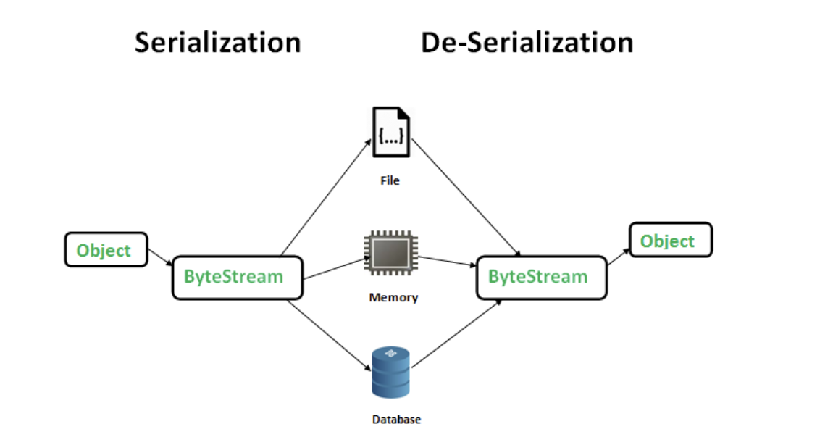

Slide 6
Important points
If a parent class has implemented Serializable interface then child class doesn’t need to implement it but vice-versa is not true.
Only non-static data members are saved via Serialization process.
Static data members and transient data members are not saved via Serialization process.So, if you don’t want to save value of a non-static data member then make it transient.
Constructor of object is never called when an object is deserialized.
Associated objects must be implementing Serializable interface.

Slide 7
class A implements Serializable{
// B also implements Serializable
// interface.
B ob=new B();
}

Slide 8
Deserialization
Deserialization is the reverse process where the byte stream is used to recreate the actual Java object in memory. This mechanism is used to persist/save the object. As Java object cannot be transferred over the network or stored. So the state of the object is converted into byte stream and this byte stream can be stored or transferred.
Further this byte stream can be used to recreate the original object.

Slide 9
package javaSerialization;
import java.io.*;
class Employee implements java.io.Serializable
{
public int empID;
public String empName;
// Default constructor
public Employee(int empid, String name)
{
this.empID = empid;
this.empName = name;
}
}

Slide 10
public class javaSerializationCls {
public static void main(String[] args) {
Employee object = new Employee(1000, "Shivam Bhardwaj");
String filename = "/Users/Shivam/shivam_tr/serDeser.txt";
// Serialization
try
{
//Saving of object in a file
FileOutputStream file = new FileOutputStream(filename);
ObjectOutputStream out = new ObjectOutputStream(file);
// Method for serialization of object
out.writeObject(object);
out.close();
file.close();
System.out.println("Object has been serialized");
}
catch(IOException ex)
{
System.out.println("IOException is caught");
}
// Deserialization
try
{
// Reading the object from a file
FileInputStream file = new FileInputStream(filename);
ObjectInputStream in = new ObjectInputStream(file);
// Method for deserialization of object
Employee object1 = (Employee)in.readObject();

Slide 11
in.close();
file.close();
System.out.println("Object has been deserialized ");
System.out.println("The id of the employee after deserialization is " + object1.empID);
System.out.println("The name of employee after deserialization is = " + object1.empName);
}
catch(IOException ex)
{
System.out.println("IOException is caught");
}
catch(ClassNotFoundException ex)
{
System.out.println("ClassNotFoundException is caught");
}
}
}

Slide 12
References:
https://www.youtube.com/watch?v=qo9S2CeoqQE&list=LL&index=1
https://www.geeksforgeeks.org/serialization-in-java/

Slide 13
THANK YOU

